Slide 1
Avoiding Common Errors
Brussels, 12th May 2020

Slide 2
The Framework Programmes timeline
2007 2014 2021
Each Framework Programme has its own rules !
Horizon Europe

Slide 3
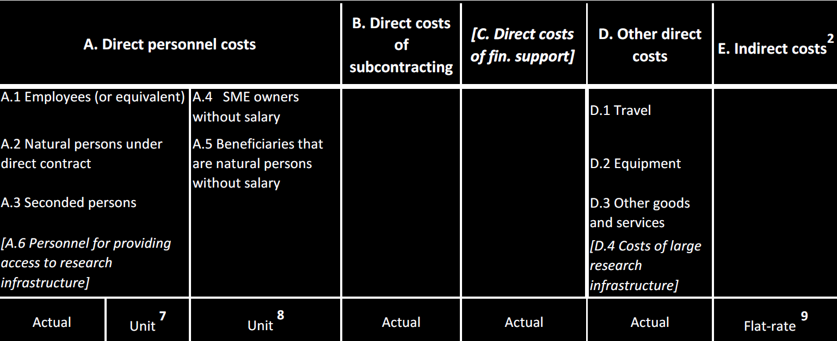
What contract under what budget category
Workforce costs

Slide 4
What contract under what budget category
What can you declare under personnel costs?
Persons hired by the beneficiary via an employment contract
(qualified as such under national law; and for whom the beneficiary pays social security contributions)
Other cases:
  → Natural persons hired directly via a contract other than an employment contract if:
  the person works under conditions similar to those of an employee (e.g. organisation or work, premises, etc.)
  The result of the work belongs to the beneficiary (exceptions may apply)
  The costs are not significantly different from those of an employee of the beneficiary doing similar tasks
  → Employees of a third party seconded to the beneficiary (must be set in Annex 1!)
NEW ! (2017)

Slide 5
What contract under what budget category
What can you NOT declare under personnel costs?
Contracts with companies to provide staff (e.g. temporary work agencies)
Natural persons (e.g. consultants) not fulfilling all the conditions mentioned in the previous slide.
e.g. working systematically off-site while employees have to work in the premises of the beneficiary
Natural persons (e.g. consultants) paid for deliverables rather than for working time
!
In the cases above the costs may be eligible under 'Other goods and services' or under 'Subcontracting' but not as personnel costs

Slide 6
Personnel costs: finding your way
Personnel costs
SME owners
Actual costs
Average costs
1B Project-based remuneration
1A Non project-based remuneration
Additional remuneration?
Basic remuneration
Monthly
Annual
Not eligible
Eligible?
Hourly rates
Above the cap
Within the cap
1720
Individual
Standard

Slide 7
Personnel costs: Calculation
Hours worked
•
Hourly rate
EUR/hour
Additional remuneration
Applies only to
beneficiaries with project-based remuneration schemes
Time records
Formula actual costs
&
specific unit costs

Slide 8
Personnel costs: hours worked for the action
Only the hours actually worked on the action can be charged.
Think of how you follow different projects
You cannot declare:
  → Budgeted time (what you indicated for the budget)
  → Estimated time (e.g. person 'guessing' at the end of the year)
  → Time allocation (e.g. x % of the contractual time of the person)
!
Hours declared to the action must be supported by reliable records and documentation !

Slide 9
Time records: supporting documents
⇨ Depend if the person works exclusively on a H2020 action or not
For this purpose, "working exclusively" refers to an uninterrupted period of at least one full calendar month during which all the hours worked by the employee for the beneficiary were dedicated to the H2020 action.
Working exclusively | Records | Conditions (full details available in the AGA; page 160)
YES | Declaration on exclusive work for the action | only one per reporting period (per person) covering one uninterrupted period of exclusive dedication of at least one calendar month
NO | Time records (i.e. timesheets) | dated and signed at least monthly by the person and his/her supervisor minimum conditions and information needed are detailed in the AGA

Slide 10
Auditor's advice: Time sheets
I work 100% on the action
so I do not have to fill in TS, correct?
Correct, but pay attention:
  Did I spend a significant part of my time building up a network with other entities or other laboratories of my company, for future projects?
  Did I spend time in writing proposals for the next calls?
  Did I give lectures for the University?
  Did I travel for other unforeseen activities?
Notes:
Christmas party

Slide 11

Auditor's advice: Time sheets (continued)
Do keep time records
Time records should include, as a minimum:
title and number of the action
beneficiary’s full name
full name, date and signature of the person working for the action
number of hours worked for the action
supervisor’s full name and signature
reference to the action tasks or work packages of Annex 1
Information included in time-sheets must match records of annual leave, sick leave, other leaves and work-related travel.
Notes:
Legal certainty as to the time recording in place

Slide 12
Personnel costs: hourly rate
SME owner without a salary
Hourly rate (unit cost) fixed in the grant by the Commission
Average personnel costs
Average hourly rate (unit cost) calculated in accordance with the beneficiary's usual cost accounting practices
Actual costs
1.A Salary is NOT project-based
1.B Salary is project-based
Per full-financial year or per month

Slide 13
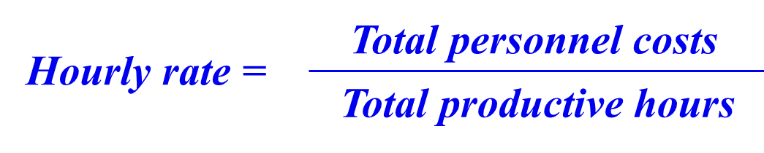

Personnel costs: hourly rate
Actual costs
1A - General case: the salary does not depend on specific projects
1B - Specific case: project-based remuneration
Subject to the provisions on
additional remuneration
!

Slide 14
ACTUAL personnel costs: hourly rate
How do I know if I am in the general case 1A or in the specific case 1B?
If your remuneration for time worked in some projects is different from your remuneration for your other duties: you are in the specific case (1B)
For example:
You get a supplementary employment contract to work in a project
You get a bonus or premium for the time worked in a project
Your contract fixes a specific hourly rate for work in specific projects
Otherwise, you are in the general case (1A)

Slide 15
Hourly rate: CASE 1A (remuneration is not project-based)
Personnel costs
Hourly rate =
Productive hours
NEW ! (2016)
Annual hourly rate
Hourly rates calculated per full financial year
Monthly hourly rate
Hourly rates calculated per month
Two options
Annual personnel costs
Monthly personnel costs
Annual productive hours
Monthly productive hours

Slide 16
Hourly rate: CASE 1A (remuneration is not project-based)
Personnel costs
Hourly rate =
Productive hours
Eligible personnel costs
Include:
Salaries
Social security contributions (employers' and employees')
Taxes and other costs included in the remuneration if they arise from national law or the employment contract
Do not include:
Any ineligible item (article 6.5)
Any costs included in other budget categories (e.g. indirect costs)

Slide 17
Hourly rate: CASE 1A (remuneration is not project-based)
Personnel costs
Hourly rate =
Productive hours
Annual productive hours
1720 hours
you must use this option if the employment contract does not specify the working time conditions or if the "annual workable hours" cannot be determined
Individual annual productive hours
Standard annual productive hours
Formula: annual workable hours + overtime - absences
According to the beneficiary's usual accounting practices. Minimum threshold: annual productive hours ≥ 90 % of the standard annual workable hours
Advice
!

Slide 18
Hourly rate: CASE 1A (remuneration is NOT project-based)
Annual productive hours options: principles
Same option applied to all personnel working in H2020 actions; although… different options for different types of personnel are possible, if:
  the same option is applied at least per group of personnel employed under similar conditions (e.g. same staff category, same type of contract, cost center, etc.); and
  the options are applied consistently (e.g. the choice of the option is not changed ad-hoc for specific employees)
keep the same option(s) for the full financial year
  Options may be changed for the next financial year

Slide 19
Hourly rate: CASE 1A (remuneration is NOT project-based)
Annual personnel costs
Annual hourly rate specificities
Annual productive hours
!
The annual hourly rate must be calculated per full financial year
If the financial year is not closed at the end of the reporting period, the beneficiary must use the hourly rate of the last closed financial year available.
01/10/2014
31/03/2016
Reporting period (example)
2014 | 2015 | 2016
Hourly rate of 2014
Hourly rate of 2015
Hourly rate of 2015 also for these months

Slide 20
Hourly rate: CASE 1A (remuneration is NOT project-based)
Monthly personnel costs
Monthly hourly rate specificities
Monthly productive hours
One hourly rate per each month the person works in the action
Monthly productive hours = 1/12 of the annual productive hours
Only options 1 (1720) and 3 (standard) are allowed. Option 2 (individual) is NOT allowed for monthly hourly rates.
Thirteen salary (and similar) included in each month "pro-rata"; not in full in the month when they are paid.
Time spent in parental leave cannot be deducted from the monthly productive hours. However, personnel costs incurred during parental leave may be charged in proportion to the time the person worked for the action.
!

Slide 21

Personnel costs: double ceiling
Beneficiaries must ensure that:
the total number of hours declared in EU and Euratom grants for a person for a year is NOT higher than the number of annual productive hours used for the calculation of the hourly rate
the total amount of personnel costs declared (for reimbursement as actual costs) in EU and Euratom grants for a person for a year is NOT higher than the total personnel costs recorded in the beneficiary’s accounts (for that person for that year).
∑ hours declared ≤ total annual productive hours
∑ cost declared ≤ total personnel costs for the person

Slide 22
Hourly rate: CASE 1B (project-based remuneration)
NEW ! (2017)
The remuneration of Ms R. is composed of:
Gross annual salary fixed by contract: 24 000 EUR + family allowance fixed in the collective labour agreement: 100 EUR/month
Besides, when she works in externally funded projects she gets an extra remuneration of 1 000 EUR per month of full dedication
No projects
Full dedication to projects
Partial dedication to projects
Ms R. would be in the specific case 1B! (her remuneration is project-based)

Slide 23
Hourly rate: CASE 1B (project-based remuneration)
NEW ! (2017)
Additional remuneration?
1
Hourly rate
2
+ Additional remuneration
Personnel costs: 'basic'
4
3
Identify what part of the remuneration of the employee is 'basic' and what part is 'additional'
Calculate the hourly rate of the employee using only the 'basic remuneration'
Multiply that hourly rate by the number of hours worked in the action
Calculate what part of the additional remuneration identified in Step 1 is eligible & add it to the result of Step 3
CASE 1B: FOUR STEPS TO CALCULATE THE PERSONNEL COSTS

Slide 24
CASE 1B: Step 1
NEW ! (2017)
What is additional remuneration?
Article 6.2.A.1: ‘Additional remuneration’ means any part of the remuneration which exceeds what the person would be paid for time worked in projects funded by national schemes.
Additional remuneration
Remuneration paid for work in national projects
BASIC remuneration
Remuneration paid to the person for work in the Horizon 2020 action
!
Additional remuneration may only be eligible for non-profit legal entities

Slide 25
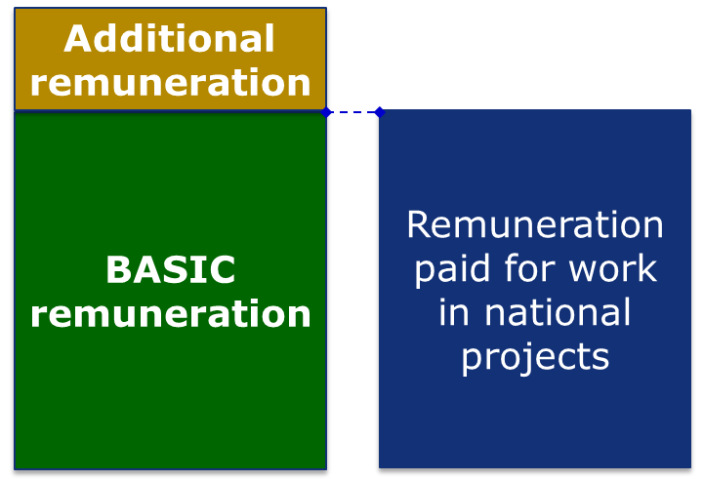
CASE 1B: Step 1
NEW ! (2017)
What is considered as remuneration paid for work in national projects?
Remuneration set out in national law or internal rules for work in national projects (it must have been paid at least once before the submission of the proposal to any employee of the entity)
Only if there is no applicable national law or internal rules:
Average of the salary of the person the previous year (excluding remuneration and time for work in H2020 actions)

Slide 26
CASE 1B: Step 1
NEW ! (2017)
What do the internal rules have to say?

Who can get the extra remuneration (e.g. which person/s or staff categories)?
€
How much extra money will they get?
It can NOT apply only to EU actions !
☑
☑
☑
What has to happen for them to get the extra remuneration?
!

Slide 27
CASE 1B: Step 1
NEW ! (2017)
What if the internal rules say…
 The director may decide an extra payment for any member of staff participating in projects
  There would not be any objective condition and the extra remuneration would not be eligible at all
 Any researcher participating in projects receiving external funds will get an extra remuneration of 20 % of its salary
  If the extra remuneration is the same regardless of the number of hours worked in the project, it would have to be divided by all the hours worked by the person (project and non-project) to calculate the eligible part.

Slide 28
CASE 1B: Step 1
NEW ! (2017)
 Any professor participating in a research project receiving external funds will get 10 € extra per hour worked in the project
  ✓ We know who will get how much when
 We do not have internal rules for the bonuses but we always pay the same bonuses in the same circumstances.
  If you actually do so, write it down in your internal rules !

Slide 29
Example (I): Identification of additional remuneration
The remuneration of Ms T. is composed of:
  Annual basic salary: 18 000 €
  Fix annual complement for seniority: 3 500 €
  Variable complements depending on her participation in research projects. Those variable complements are paid based on the internal rules of the entity.
  In 2016 she worked 860 hours in the Horizon 2020 action and she got 12 900 € extra for that work.
  The beneficiary uses 1720 as annual productive hours and calculate annual hourly rates.
  Is any part of her salary 'additional remuneration'?
  If so, how much?

Slide 30
Example (I): Identification of additional remuneration
  …. It depends on:
    What the internal rules say
    What the entity has paid in past for work in national projects
Example (follow up):
  The internal rules say that employees working in externally-funded research projects may get up to 2 500 € extra per month of full dedication
  Due to budgetary restrictions, the maximum paid by the entity as extra to any person is 1 433 € per month of full dedication

Slide 31
Example (I): Identification of additional remuneration
  Additional remuneration =
  Hourly rate of the person for work in the H2020 action (action reference)
  minus Hourly rate paid for national projects (national reference)
  Fix salary
  Project bonus
  Action reference = ((18 000 + 3 500)/1720) + (12 900 / 860)
  12,5 + 15 = 27,5 €
  National reference = ((18 000 + 3 500)/1720) + (1 433/ (1720/12))
  12,5 + 10 = 22,5 €
  Additional remuneration = 27,5 – 22,5 = 5 €/hour x 860 hours = 4 300 €

Slide 32
CASE 1B: Step 2 and Step 3
NEW ! (2017)
Basic remuneration Hourly Rate
EUR/hour
Hours worked for the H2020 action
•
Example (II): Calculate the 'basic' personnel costs
  'Basic' personnel costs = 22,5 €/hour x 860 hours = 19 350 €

Slide 33
Additional remuneration ceiling
Additional remuneration
Eligible additional remuneration is subject to a eligibility ceiling fixed at EUR 8 000 for a full-time employee working exclusively for the action during the entire year.
Occupation | Contract
 | hired full time during the entire year | NOT hired full time during the entire year
working exclusively for the EU action during the entire year | EUR 8 000 | pro-rata amount of EUR 8 000
NOT working exclusively for the EU action during the entire year | {8 000 / annual productive hours FTE} * hours worked for the action over the year
!
The ceiling covers the additional salary + all additional taxes, costs and social security contributions triggered by the additional salary.

Slide 34
Example (III): Add eligible additional remuneration (Step 4)
  'Basic' personnel costs = 22,5 €/hour x 860 hours = 19 350 €
  Additional remuneration = 27,5 – 22,5 = 5 €/hour x 860 hours = 4 300 €
  If for-profit: eligible additional remuneration = Ø
  Personnel costs = 19 350 + 0 = 19 350 €
LEGAL ENTITY
  If non-profit: additional remuneration eligible up to the pro-rata of the ceiling
  Pro-rata = (8 000 / 1720) x 860 = 4 000 €
  Paid (4 300) > Pro-rata (4 000) ➔ 300 € ineligible
  Personnel costs 2016 = 19 350 + 4 000 = 23 350 €

Slide 35
Personnel costs: bonuses
Arbitrary bonuses
Bonus based on commercial targets (e.g. sales target), fund raising targets or representing profit distribution (dividends)
Bonus applied only to EU actions
Ineligible
Triggered by specific projects and resulting in a level of remuneration higher than under national projects
Paid for additional work or expertise
Part of the usual remuneration practices of the entity
Based on objective criteria established in the internal rules
Eligible only for non-profit legal entities
Additional Remuneration
BONUSES
!
If not triggered by specific projects OR if triggered by projects, up to the level of remuneration paid in national projects
Scheme authorised by law, collective agreement of contract
Determined using objective criteria established in the internal rules
(also) Basic Remuneration

Slide 36
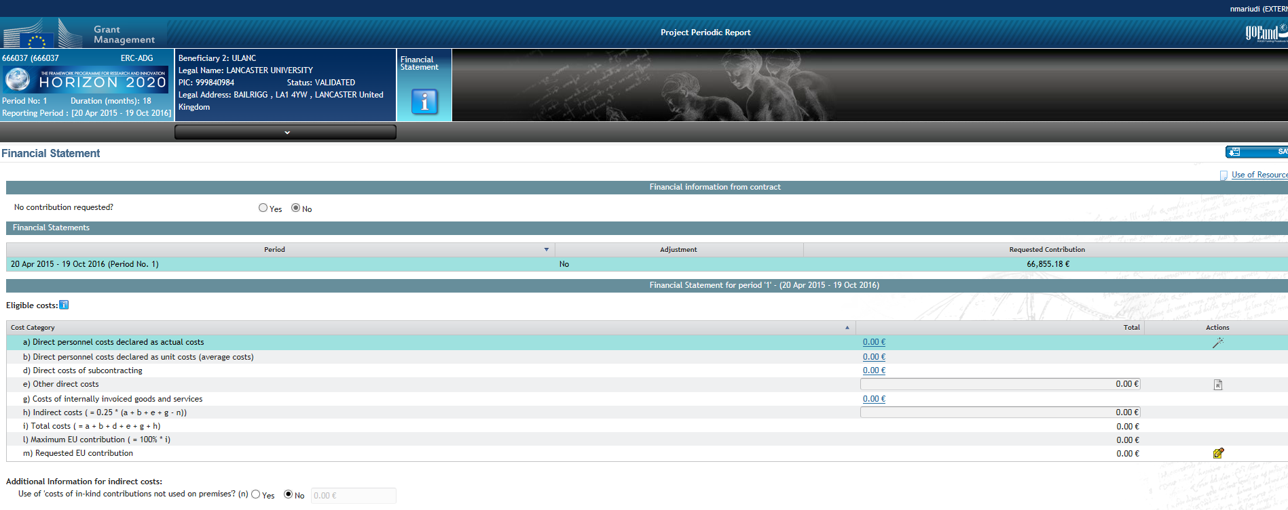
STILL PUZZLED?
Why don’t you try the Personnel Cost Wizard?
Wizard entry point

Slide 37

Direct costs for the action
Direct costs are costs that are directly linked to the action's implementation and can be attributed to it directly. They must not include any indirect costs
Direct costs are:
costs that have been caused in full by the action
or costs that have been caused in full by several actions and the attribution to a single action can, and has been, directly measured (e.g. not allocated via cost drivers)
Identification of Direct Costs:
Measurement

Slide 38
Direct costs for the action
Must be justified by sufficient persuasive evidence showing the direct link to the action
Must be properly recorded in order to allow direct measurement of the use for the action and to ensure auditability
The measurement system used by the beneficiary must accurately quantify the cost
Direct measurement of costs does not mean fair apportionment of costs through proxies, cost drivers or allocation keys. Once you use them, it's indirect cost!
In principle, what was considered direct/indirect in FP7 remains the same in H2020 Now, it is even more important because Indirect Cost is calculated at 25% flat rate
But

Slide 39
Examples (1)
A beneficiary uses a x-ray machine for the action for few hours and for the rest of the time the x-ray machine is used for other activities. The beneficiary charges the full depreciation costs for the period in the cost statement of the action.
NOT ALLOWED!
The allocation of the part of the annual depreciation to the H2020 action must be calculated based on the number of hours/days/months of actual use of equipment for the action. The actual use should be directly measured (logbook, etc.).

Slide 40
Examples (2)
The total consumables costs are charged as direct costs on the H2020 action as proportion of the action hours to total worked hours in the laboratory.
NOT ALLOWED!
Even if the usual accounting practice of a beneficiary is to consider laboratory consumables as direct costs.
The costs of other goods and services should be declared as actual costs e.g. direct consumption for the action should be measured.

Slide 41
Auditor's advice: direct measurement
In FP7, energy and power supply was an indirect cost:
can I charge it as direct in H2020?
  Yes, if I can measure it…
Administrative staff members doing accounting for the action:
can I charge them to the action?
  Yes, with time sheets and provided it is your usual practice…
Multi-purpose equipment used for several activities/actions:
can I charge its depreciation to an EU action as a % of total capacity based on my experience?
  No. I have to measure its use.

Slide 42
Third parties: summary
Types of third parties | CHARACTERISTICS
 | Does work of the action | Provides resources or services | What is eligible? | Must be indicated in Annex 1 | Indirect costs | Selecting the third party | Articles
Linked third party | YES | NO | Costs | YES | YES | Must be affiliated or have a legal link | Article 14
Subcontractors | YES | NO | Price | YES | NO | Best value for money, avoid conflict of interest | Article 13
International partners | YES | NO | No EU funding | YES | No EU funding | Partner to one beneficiary | Article 14a
In-kind contributions by third parties | NO | YES | Costs | YES | YES | Not used to circumvent the rules | Articles 11 and 12
Contractors | NO | YES | Price | NO | YES | Best value for money, avoid conflict of interest | Article 10
Financial support to third parties | Only if allowed in the call The beneficiaries’ activity consists in providing financial support to the target population |  |  | YES | NO | According to the conditions in Annex 1 | Article 15

Slide 43
Third parties: Warnings !
Linked third party
Third party providing in-kind contributions
Goods
Services
Works
Subcontractor
Beneficiary
!
The beneficiary retains the sole responsibility for the work and the costs declared !
If something goes wrong with the third party, the beneficiary will be responsible
!
The beneficiary must ensure that Commission, OLAF and European Court of Auditors can audit its third parties including subcontractors and providers
In case of an audit to a 3rd party, the beneficiary is also in copy of all relevant communications (announcement of the audit, audit report, etc.)

Slide 44


Best Practice
Do not wait for an audit!
At grant signature:
Foresee and justify all subcontracts
in Annexes 1 & 2
During the grant execution:
  Ask for amendment to include subcontracts
  Justify subcontracts in the technical reports
  Communicate clearly and in writing with the project officers

Slide 45

Best Practice
You must demonstrate 'best value for money' both, in sub-contracting and in purchases of goods
Some level of tendering to demonstrate 'best value'
– e.g. tender, three offers, market survey, etc.
Naming the supplier in the grant does not mean that you do not have to demonstrate best value
We will normally accept your standard practices, when properly used
!
Your accounting practices are not panacea!
(e.g. cash basis depreciation is not automatically accepted even if it is in line with your accounting practices)

Slide 46
Avoid conflict of interests
(Art.35 of the MGA)
Conflict of interests
'The beneficiaries must take all measures to prevent any situation where the impartial and objective implementation of the action is compromised for reasons involving economic interest, political or national affinity, family or emotional ties or any other shared interest (‘conflict of interests’).'

Slide 47
Avoid conflict of interests
(Art.35 of the MGA)
Conflict of interests
The beneficiaries must formally notify the EC/Agency without delay any situation constituting or likely to lead to a conflict of interests and immediately take all the necessary steps to rectify this situation.
Non-compliance may have consequences (reduction of grant, termination).

Slide 48
Additional info
Funding & tender opportunities Portal
https://ec.europa.eu/info/funding-tenders/opportunities/portal/screen/home
Horizon 2020 Annotated Grant Agreement http://ec.europa.eu/research/participants/data/ref/h2020/grants_manual/amga/h2020-amga_en.pdf
Horizon 2020 On-line Manual http://ec.europa.eu/research/participants/docs/h2020-funding-guide/index_en.htm
H2020 Indicative Audit Programme
http://ec.europa.eu/research/participants/data/ref/h2020/other/gm/audit/h2020-iap_en.pdf
Questions? Research Enquiry Service http://ec.europa.eu/research/enquiries
Notes:
The Funding and Tender Opportunities was previously named Participants portal.

Slide 49
Thank you!
Find out more:
http://ec.europa.eu/programmes/horizon2020/

